Slide 1

© 2002, Cisco Systems, Inc. All rights reserved.

Slide 2

Enabling RIP
© 2002, Cisco Systems, Inc. All rights reserved.
Notes:
Purpose: This chapter introduces the Cisco IOS™ CLI on the Catalyst® 1900 switch and router.
Timing: This chapter should take about 2 hours to present.
Note: The Catalyst 1900 switch only has a subset of the router Cisco IOS commands available.
Contents:
Introduction to Cisco IOS. Explain to the student what is IOS?
Cisco Device startup procedures in general.
IOS configuration source.
General introduction to the IOS CLI.
Cat 1900 switch startup procedures.
Intro to Cat 1900 CLI. This part covers the basic configuration on the switch, like setting the IP address and hostname. More details about the various Cat 1900 switch configuration commands are explained in Chapter 6 and 7.
Router startup procedures. More details on the router startup process is discussed in chapter 5.
Router IOS CLI.

Slide 3
Objectives
Upon completing this lesson, you will be able to:
  Describe the features and operation of RIP
  Use Cisco IOS commands to configure dynamic routing using RIP, given a functioning router
  Use show and debug commands to identify anomalies in dynamic routing operation using RIP, given an operational router
Notes:
Slide 1 of 2
Purpose: This slide states the chapter objectives.
Emphasize: Read or state each objective so that each student has a clear understanding of the chapter objectives.
Note: Catalyst switches have different CLIs. The Catalyst 2900xl and the Catalyst 1900 has a Cisco IOS CLI. The Cisco IOS CLI commands available on the 2900xl is different from the 1900. The Catalyst 5000 family has no Cisco IOS CLI, and use the set commands instead. This class only covers the configuration on the Catalyst 1900 switch.

Slide 4
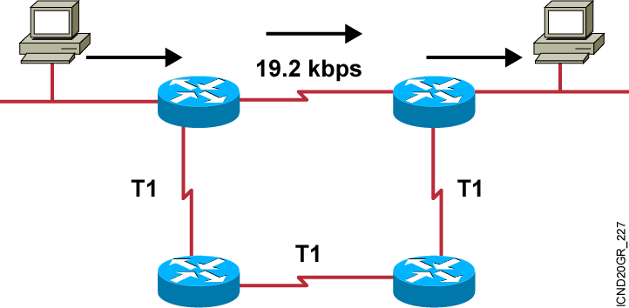
RIP Overview
  Maximum is 6 paths (default = 4)
  Hop-count metric selects the path
  Routes update every 30 seconds
Notes:
Purpose: This figure presents general information about RIP.
Emphasize: The figure shows a network. The arrows highlight the path RIP selects. RIP selects the best path based on the shortest hop count, so it ignores the path with the faster T1 links.
Be sure that you do not disparage RIP. It was developed in a homogeneous network. If everything is connected via a single media type, then bandwidth-based metrics reduce to hop count. In some cases, RIP is more appropriate than other protocols. It is extremely well tested.

Slide 5
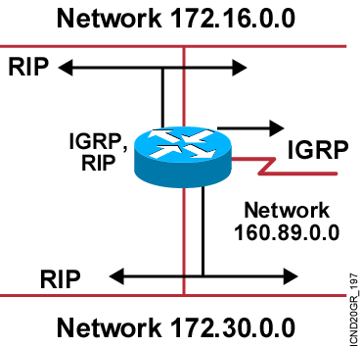
IP Routing
Configuration Tasks
Router configuration
  Select routing protocols.
  Specify networks or interfaces.
Notes:
Purpose: This figure defines the tasks needed to configure IP routing.
Emphasize: This is a general overview of tasks, so the graphic shows both IGRP and RIP in the protocol box.
Tell your students that the router is able to route using both RIP and IGRP. It is possible to run IGRP and RIP concurrently. The IGRP information will override the RIP information by default because of IGRP’s administrative distance.
However, running IGRP and RIP concurrently does not work well when the network topology changes. Because IGRP and RIP have different update timers, and because they require different amounts of time to propagate routing updates, one part of the network may end up believing IGRP routes and another part may end up believing RIP routes. This will result in routing loops.
Review the fundamentals of router-configuration and interface-configuration modes.
Transition: The command to enable dynamic routing follows.

Slide 6
Dynamic Routing Configuration
Router(config)#router protocol [keyword]
  Defines an IP routing protocol
Router(config-router)#network network-number
Mandatory configuration command for each
IP routing process
Identifies the physically connected network that routing updates are forwarded to
Notes:
Purpose: This figure shows the dynamic routing configuration commands.
Emphasize: The router command starts a routing process. Field descriptions are as follows:
protocol—One of the following: RIP, IGRP, HELLO, OSPF, BGP, or EGP
autonomous system—Used with protocols which require an AS, such as IGRP and BGP
A proper understanding of these commands will avoid many problems in the labs.
The network statement contains no subnetting information. Networks are directly connected and are specified as the major Class A, B, or C network numbers.
Transition: The next section describes the RIP routing protocol.

Slide 7
RIP Configuration
Router(config)#router rip
  Starts the RIP routing process
Router(config-router)#network network-number
Selects participating attached networks
Requires a major classful network number
Notes:
Purpose: This figure presents the Cisco IOS™ commands used to configure RIP.
Emphasize: The figure shows the router rip command and the network network-number command. A proper understanding of these commands will save many problems in the lab.
Point out that the network statement contains no subnetting information.
Networks are directly connected and are specified as a Class A, B, or C network number.
Transition: An example of configuration follows.

Slide 8
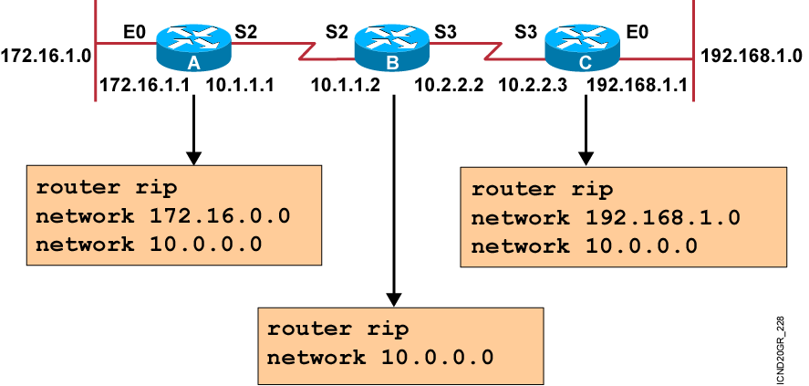
RIP Configuration Example
Notes:
Purpose: The figure shows how the RIP commands operate on the example network.
Emphasize: An administrator only specifies directly connected networks that should be published to other routers.
Without the network command, nothing is advertised. With a network command, the router will advertise every subnet within the Class A, B, or C network specified in the configuration.

Slide 9
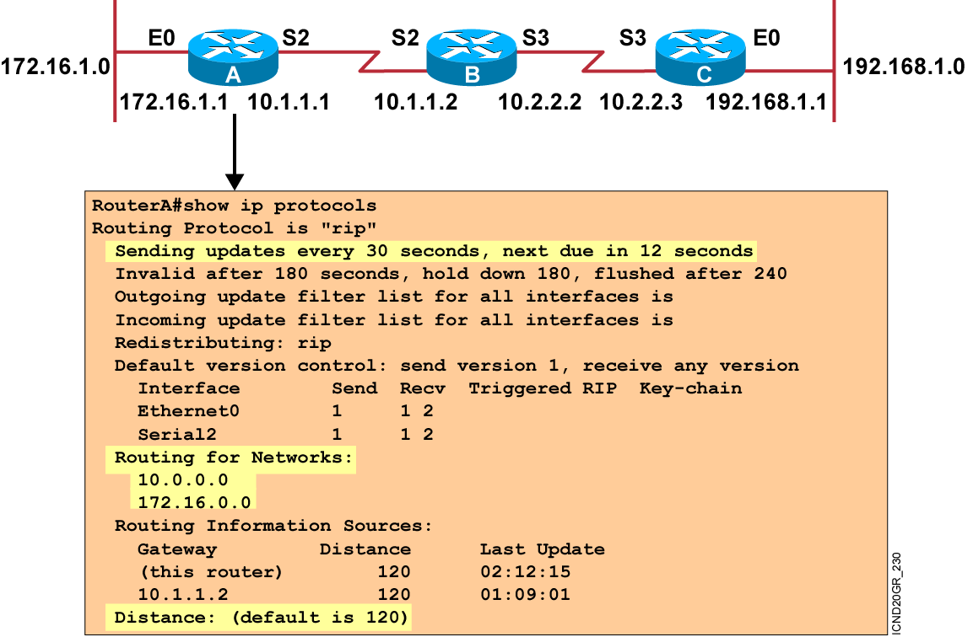
Verifying the RIP Configuration
Notes:
Purpose: This figure shows how the show ip protocol command is used to monitor RIP operation.
Emphasize: The command displays the routing protocols that are active on the router for IP. It also gives network and timer information.
Point out the timing information.
Point out the list of networks for which the router is injecting routes.
Point out the administrative distance metric.

Slide 10
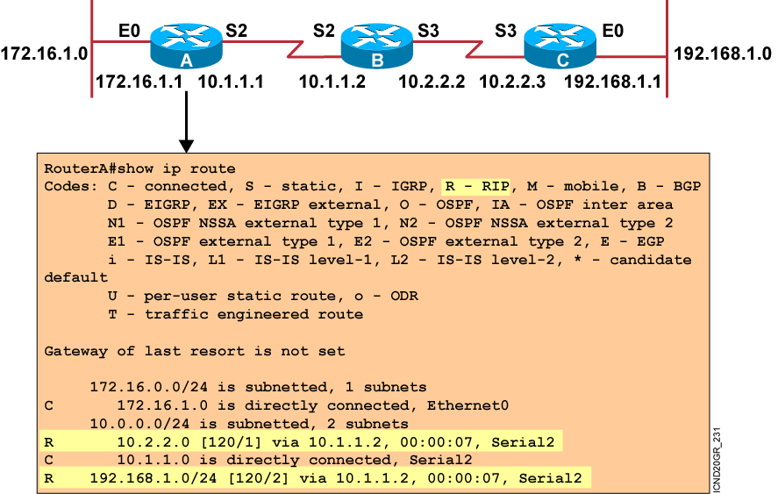
Displaying the
IP Routing Table
Notes:
Purpose: This figure displays the show ip route command, which displays the contents of the router’s IP routing table.
Emphasize: Discuss the IP routing table in detail. Show the locations of the hop count (metric) and the administrative distance (120).
Discuss the following fields:
R—Refers to routes learned from RIP.
via—Refers to the router that informed us about this route.
00:00:07 timer value—RIP updates are every 30 seconds. Ask, “How long until the next update?”
The interfaces used for the best path

Slide 11
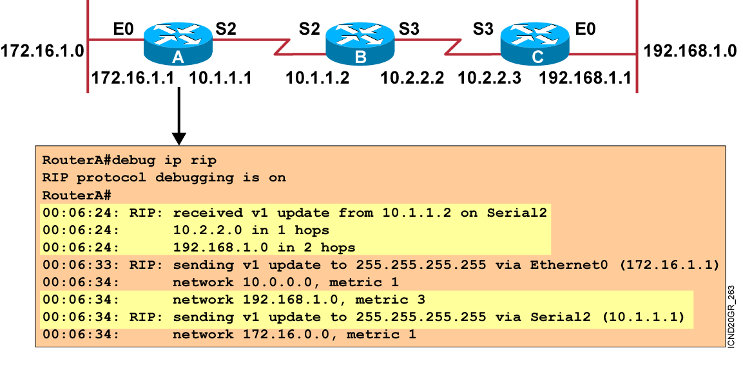
debug ip rip Command
Notes:
Purpose: This figure shows the debug ip rip command.
Emphasize: Explain that debug commands also provide information for monitoring IP.
The first highlighted line lists the source of the updates. The router returned information about two destinations.
The last highlighted line shows the broadcast address to which the router sent updates.

Slide 12
Summary
  RIP is a distance vector routing protocol that uses hop count as the metric for route selection and broadcasts routing updates every 30 seconds.
  To enable a dynamic routing protocol, you will select the routing protocol and then assign IP network numbers.
  The router rip command specifies RIP as the routing protocol. The network command identifies a participating attached network.
  The show ip commands display information about routing protocols and the routing table.
  Use the debug ip rip command to display information on RIP routing transactions.
Notes:
Purpose: This slide discuss the initial configurations on the routers and switches.
Note: There is no setup mode on the Catalyst 1900 switch.

Slide 13


